Slide 1


SPI Code Example
MR-E-2 + Raspberry Pi
Zurich, 04.10.2019
Panagiotis Tsolakos
Bernstrasse 388 | CH-8953 Dietikon | Switzerland
Phone +41 58 856 3000 | www.optotune.com | info@optotune.com

Slide 2
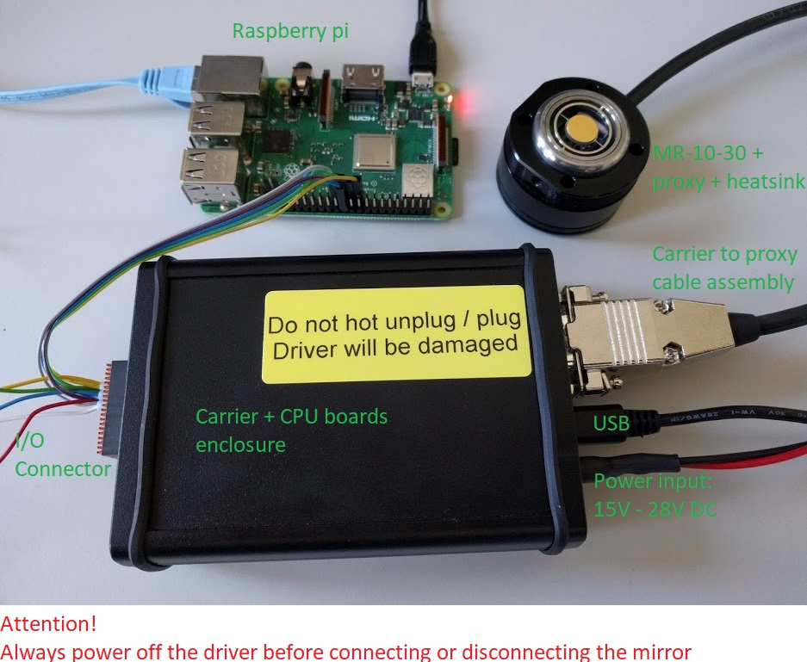
System overview

Slide 3
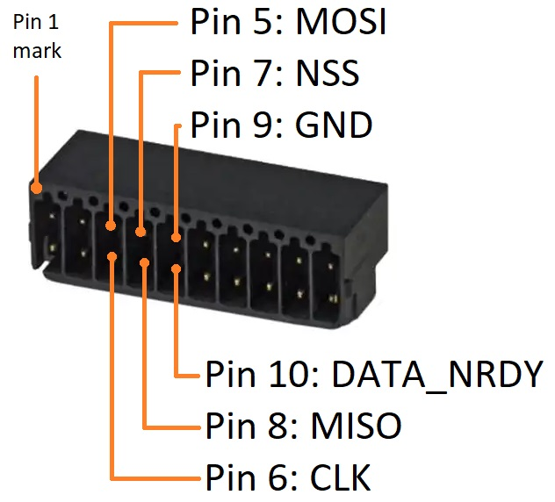
SPI bus in MR-E-2 I/O Connector

Slide 4
SPI protocol documentation
General MR-E-2 firmware documentation (includes documentation on SPI): https://archive.optotune.com/MR-E-2_Firmware_Documentation.zip

Slide 5
SPI control with Raspberry pi
./SPI example with raspberry pi contains python example code to control the MR-E-2 driver through SPI
SPIDevice.py : Utility module that implements MR-E-2 SPI protocol
mr1030.py : Configures MR-E-2 and logs the Optical Feedback in a file
Connect MR-E-2 SPI bus with raspberry pi SPI bus 0, device 0
Run python3 MR_E_2.py
The script configures the MR-E-2 to perform a sine wave (frequency to be adjusted) in the resonant axis in open loop control and a low frequency triangular wave in the quasi-static axis in optical feedback closed loop control. Works with both the MR-10-30 and the MR-15-30.

Slide 6
Data

Slide 7
SPI point to point control at 10kHz
In the above example the raspberry pi is configuring the MR-E-2 to generate the desired waveforms and logs the optical feedback.
The SPI clock of the raspberry pi is configured so that the logging frequency is as close as possible to the 10kHz control frequency of the MR-E-2 driver
This example with the raspberry pi and the waveform generation capability of the MR-E-2 was chosen as a simple demonstration of the MR-E-2 SPI interface. For accurate time synchronisation and point to point control at 10kHz, a hardware trigger on the DATA_NRDY has to be used. An example using a ST Nucleo development board can be provided

